Slide 1
Special Diets
9.9.24

Slide 2
What Constitutes a Special Diet?
Special Diets are provided to students with physical or mental impairment.
A current Medical Statement to Request a Special Meals form must be completed and signed by Medical Authority
This form must be completed in its entirety and returned to school cafeteria. If the form is not complete, the special diet cannot be processed

Slide 3
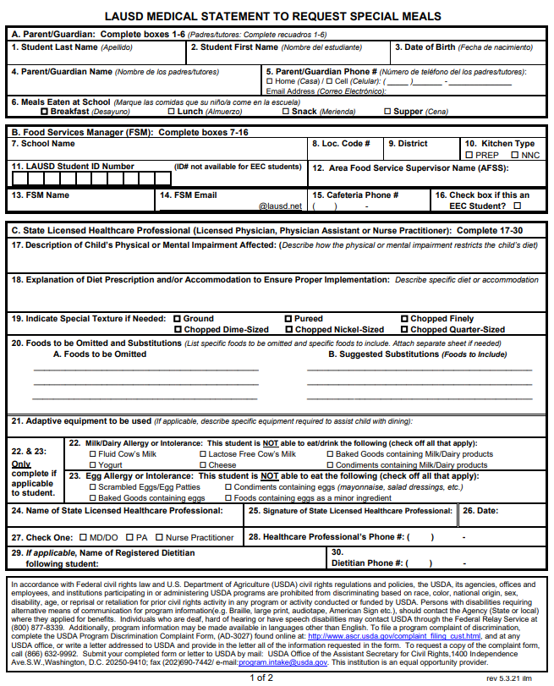
First-Time Special Diet Request
The FSM follows the “Procedures for Requesting Special Meals” for NEW special diet requests:
FSM provides the Medical Statement to Request Special Diets form to families for completion by the medical professional treating the child
FSM emails the completed form to: specialdiet@lausd.net
FSM makes substitutions based on the special diet provided by the Nutrition Specialist
Incomplete forms emailed to specialdiet@lausd.net will be returned to FSM.

Slide 4
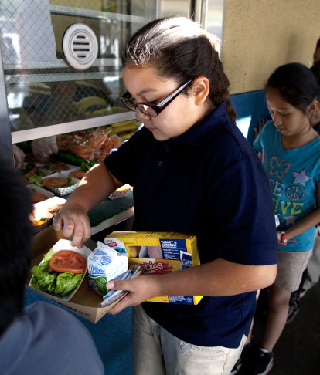
Renewing Last Year’s Special Diet Request
Special Diets do not automatically carry over to the next school year. Parents must renew the special diet request every school year.
If there are no changes to the student’s special diet from last year, then the parent can renew by signing and dating the bottom of the special diet form filed in the cafeteria
If there are changes to the student’s special diet from last year, then parent must submit a new Special Diet Form

Slide 5
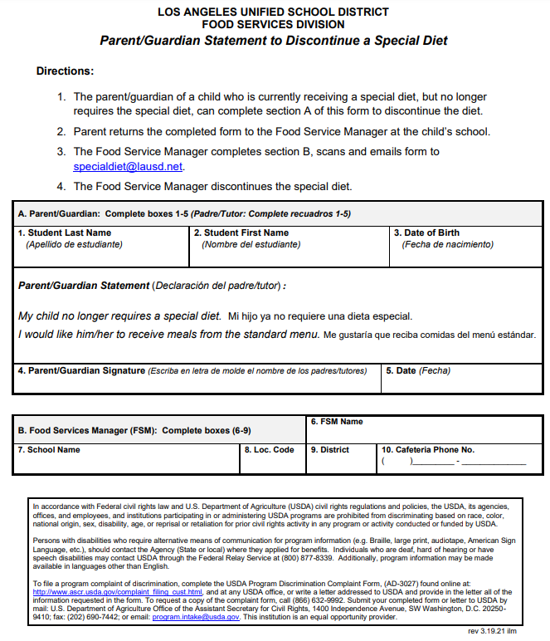
Discontinuing Special Meals
To discontinue a special diet for a child who is currently receiving special meals:
Parent/guardian must complete the Parent/Guardian Statement to Discontinue a Special Diet form
FSM must send completed form to specialdiet@lausd.net

Slide 6
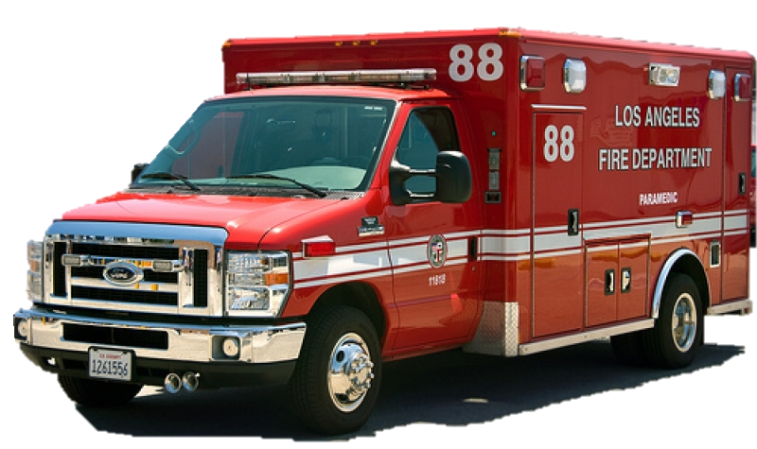
Importance of Following Special Diet Guidelines
Make sure staff follow special diet guidelines provided by the Nutrition Specialist and never assume or guess what is allowed for a student.
Some food allergies can have very serious consequences such as anaphylaxis. Results can be fatal!
Make sure every worker knows which students receive special diets and where the guidelines for these students are located so they can refer to them if needed
If a special diet meal is prepared for a student, make sure it is labeled properly, and staff know where the meal is located when time to serve

Slide 7
Personal Preferences
LAUSD does not accommodate special diets based on personal preferences or religious convictions.
Students can request vegetarian meals. Special Diet form not needed.

Slide 8
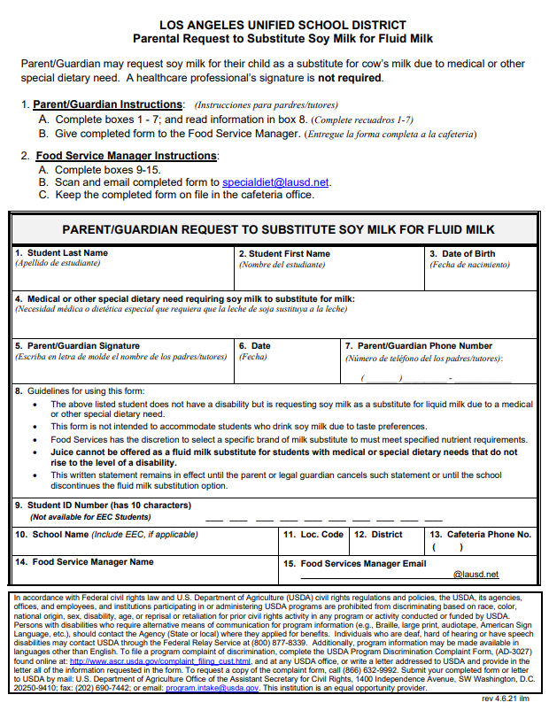
Fluid Milk Substitutions
Parents/Guardians may request soy milk for their child as a substitute for fluid milk due to medical or other special dietary needs.
The Parent/Guardian Request to Substitute Soy Milk for Fluid Milk form must be completed and given to the Food Service Manager
A medical authority signature is not required
Lactose-Free milk can be provided to students if requested. No form required
Students requesting almond or rice milk need a completed Medical Statement to Request Special Meals form.

Slide 9
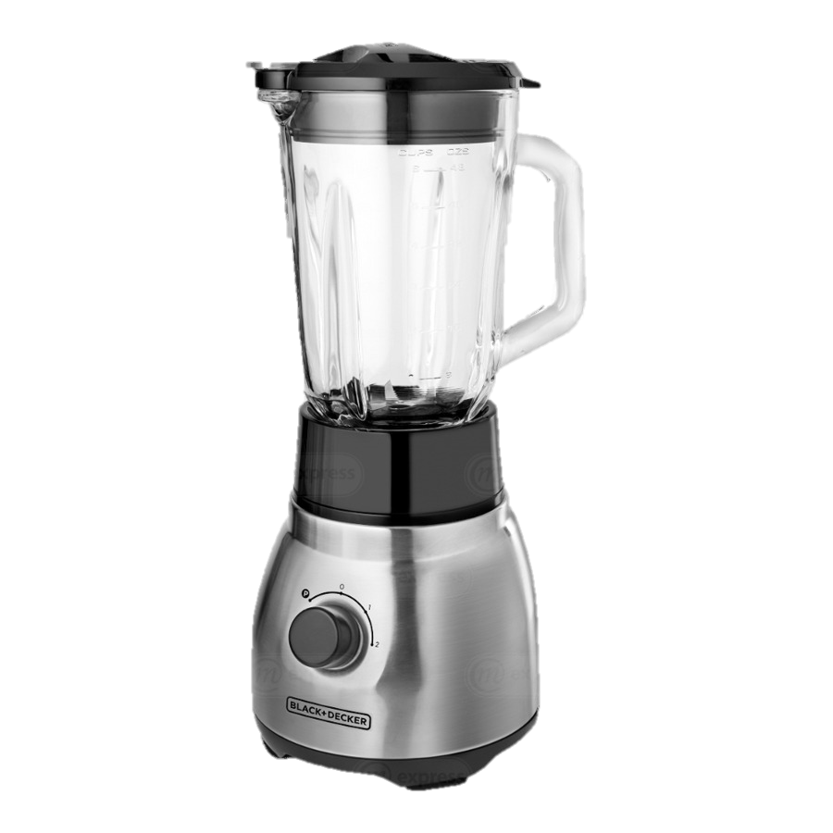
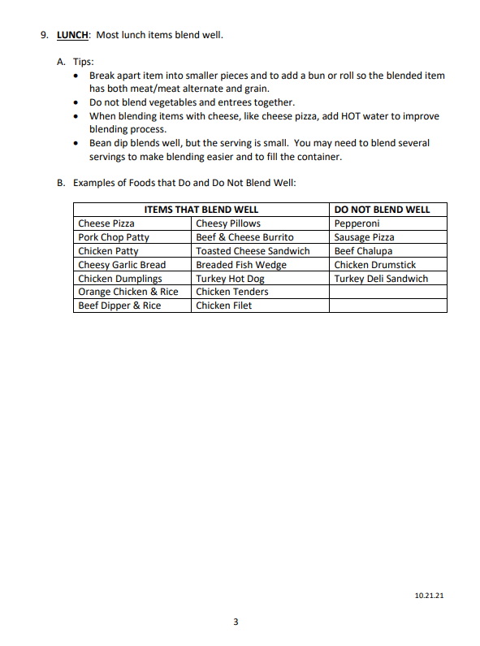
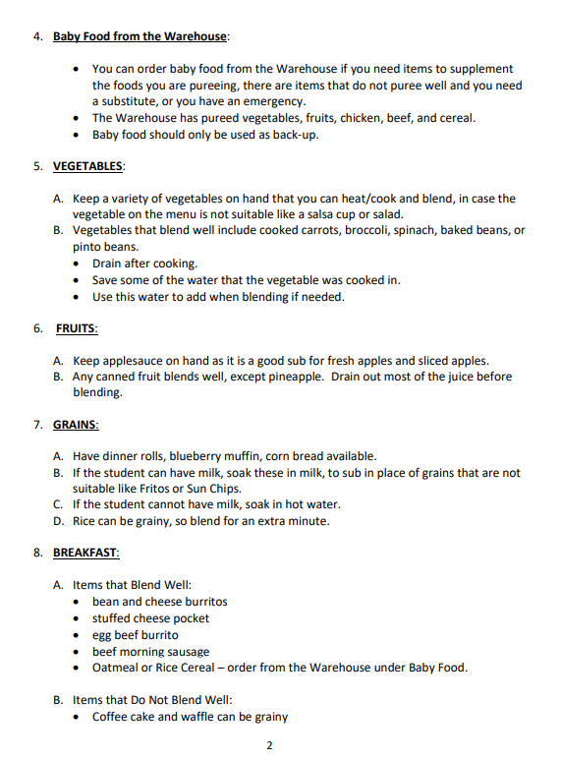
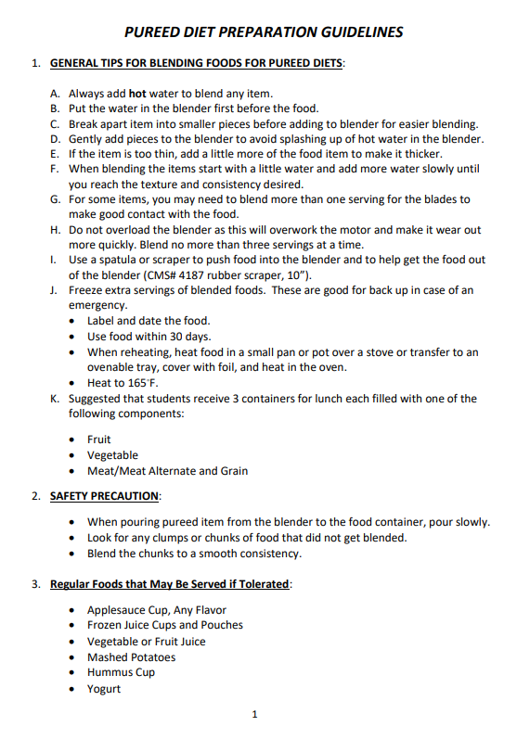
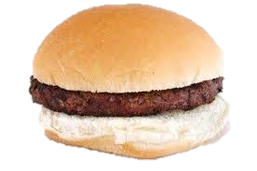
Modified Texture
For students that require a modified texture special diet, there are guidelines posted on Café LA website.
Go to: Menu > Special Diets > Pureed Diet Preparation Guidelines

Slide 10
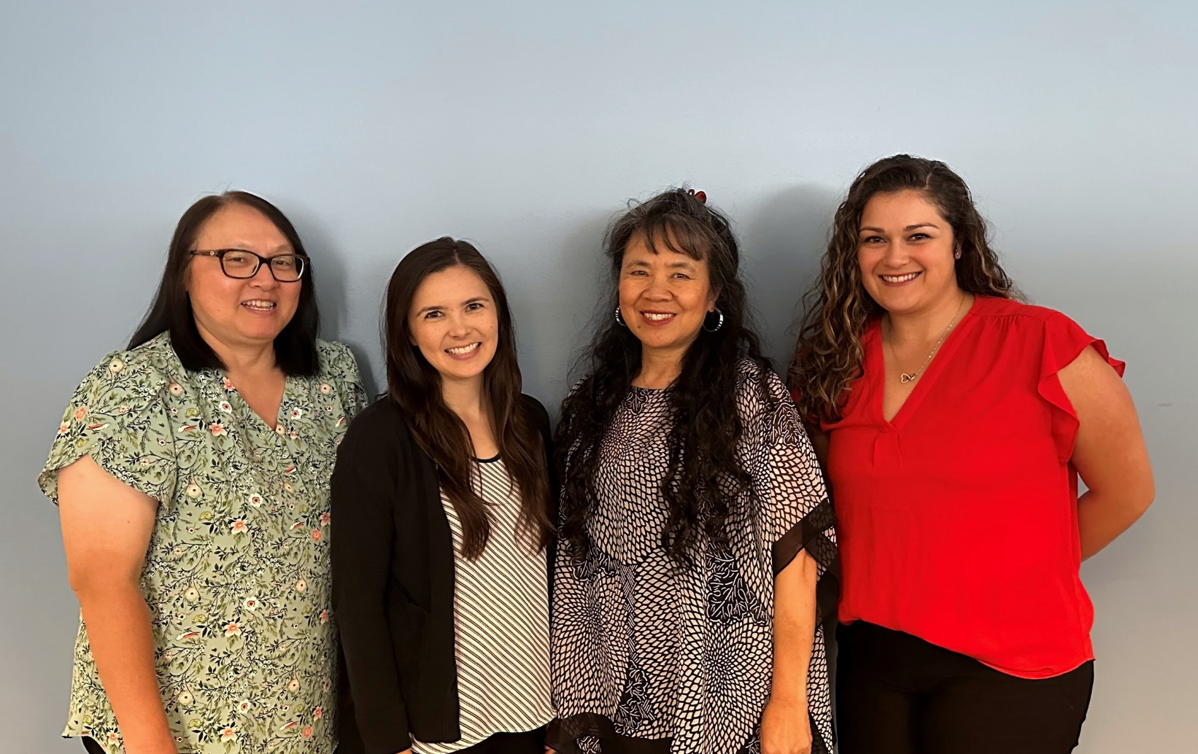
Kim Nguyen
Meet Our Nutrition Specialist Team
Special thanks to our team who handle special diet requests.
Kayley Drain
Ivy Marx
Bobbie Diamond

Slide 11
Thank You!

